Slide 1
Analysers & Instruments department
Flame detectors – Ruby Packscan, Safyr Packscan, Darkscan
September 29th, 2015
Prepared by: Bernard Lafont

Slide 2
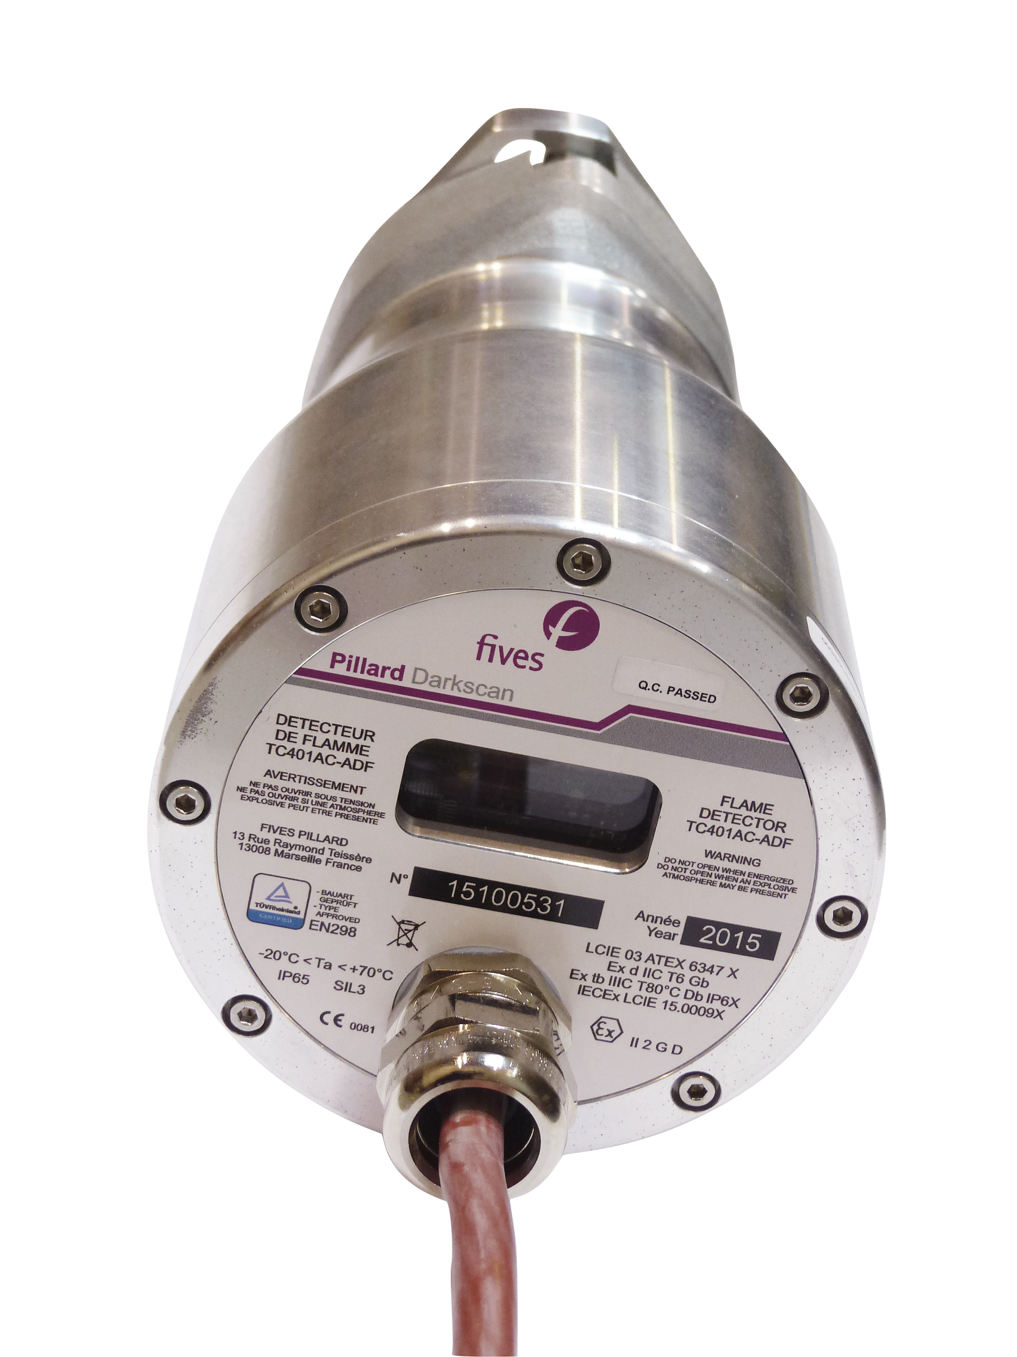
Flame detectors – Ruby Packscan, Safyr Packscan, Darkscan
Product visual presentation
Ruby Packscan | Darkscan | Safyr Packscan

Slide 3
Flame detectors – Ruby Packscan, Safyr Packscan, Darkscan
Product use
Purpose | Detect the presence or absence of the burner flame
Interest | Avoid the risk of explosions for installations ensuring safety of the installation
Target | Industrial burners
Industries concerned | Energy, Petrochemical, Chemical, Cement plants, Food industry, Paper mills |  | Claus unit

Slide 4
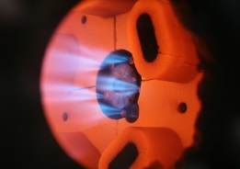
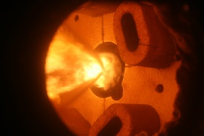
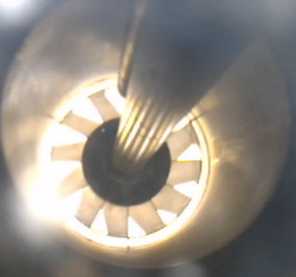
Flame detectors – Ruby Packscan, Safyr Packscan, Darkscan
Operating principle
 | Ruby Packscan | Safyr Packscan | Darkscan
Flame type | Generates UV | Yellow | Colourless
Burner fuel | Gas / Diesel oil | Heavy oil / Coal | Acid gas
Principle | Measures the Ultraviolet given by the flame | Measures frequency (variation in light intensity) of the flame | Measures the difference in temperature between two parts of a flame
Technology | Ultraviolet | Visible & IR | Pyrometric

Slide 5
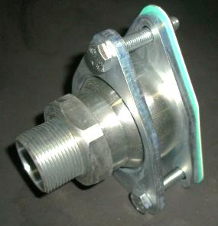

Flame detectors – Ruby Packscan, Safyr Packscan, Darkscan
Product description
Viewing window
Fixed to burner face
Cable gland or
Connector plug
Electric cable
RUBY PACKSCAN UV283AC-ADF detector
(Similar to the SAFYR PACKSCAN and DARKSCAN detectors)

Slide 6
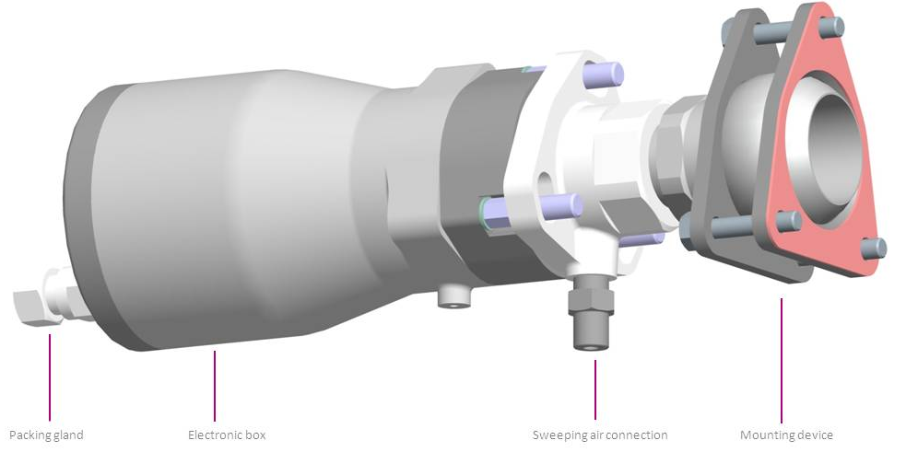
Flame detectors – Ruby Packscan, Safyr Packscan, Darkscan
Product description
Weight : 4,8 kg
Ambient operating temperature : -20°C to +70°C
Storage temperature : -30°C to +90°C

Slide 7
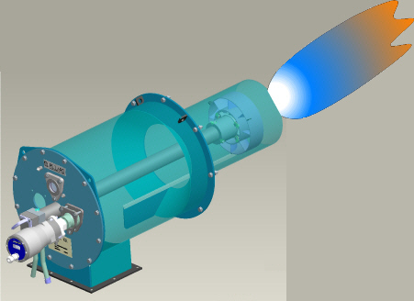
Fitting into place
Example of assembly on a GRX burner:
Burner front face
Visée
Flame detector
Swivel mount
(adjustment for the best line of sight on the burner flame allowing optimal detection)

Slide 8
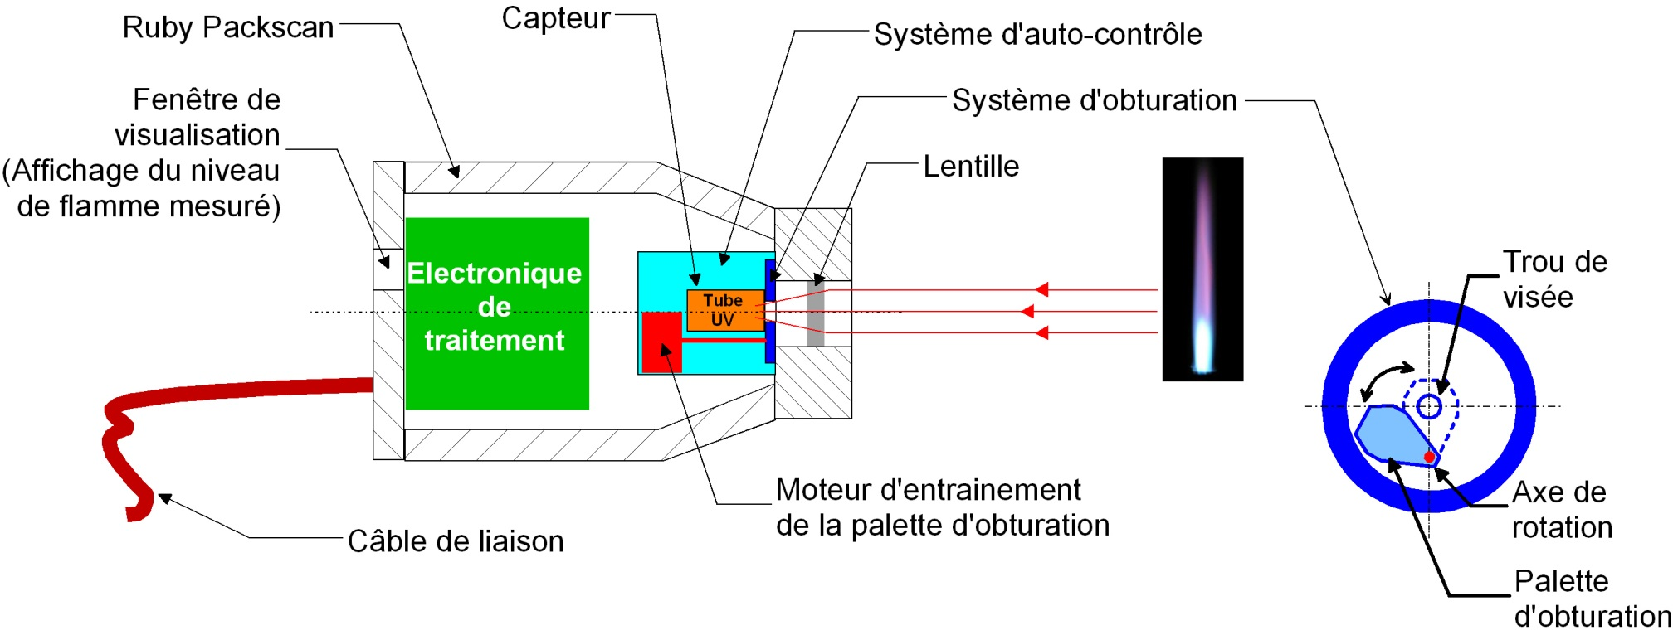
RUBY PACKSCAN description
Basic principle
The Ruby Packscan sensor is comprised of a UV detection tube which contains a gas. This gas ionises (becomes a conductor) in the presence of the Ultraviolet given out by some flames.
Ruby Packscan Detector
Sensor
Self checking system
Window
Locking system
Lens
PCB
Hole sight
Step by step motor
Axis of rotation
Shutter
Cable
Self-checking device :
The gas contained in the UV tube has a fault of ionising without any UV when it ages.
In order to maintain the safety of the system, a self-checking system (PILLARD patent n°90.10795) comprises of a mechanical shutter driven by a motor, which periodically closes the line of sight on the flame whilst the electronics checks for the absence of a signal.

Slide 9
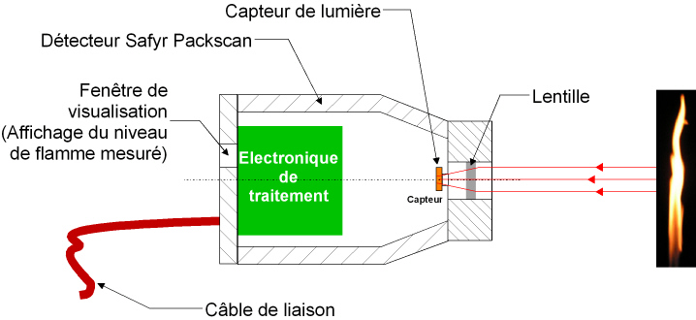
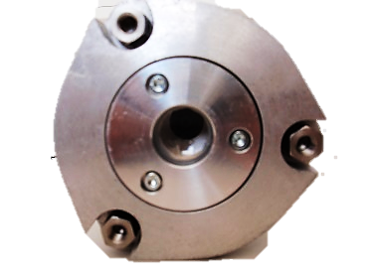
SAFYR PACKSCAN description
Sensor
Basic principle
Safyr Packscan Detector
Window
Lens
PCB
Cable
Safyr Packscan detector:
  Operation of the Safyr Packscan is based on the detection of the characteristic flickering of flames, by a light sensor.
  The value of the measured frequency is compared to a value defined during commissioning to generate a "flame presence" signal.
  The detector comprises 2 microcontrollers (mini processors) which periodically check (twice per second), the proper operation of the sensor and of its various electronics parts.

Slide 10
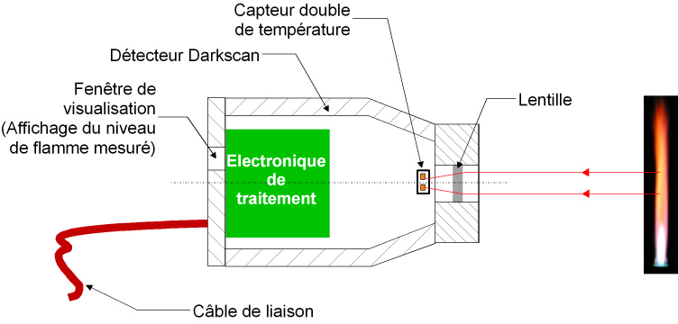
DARKSCAN description
Basic principle
Dual temperature sensor
Darkscan Detector
Window
Lens
PCB
Cable
Darkscan detector:
  The operation of this detector is based on measuring the variation in temperature difference between two points in a flame.
  The use of a double thermocouple, in order to measure flame temperature variations, avoids the risk of detecting a fixed surface (such as a wall, bricks etc.) .
  The detector comprises 2 microcontrollers (mini processors) which periodically check (twice per second), the proper operation of the sensor and of its various electronics parts.

Slide 11
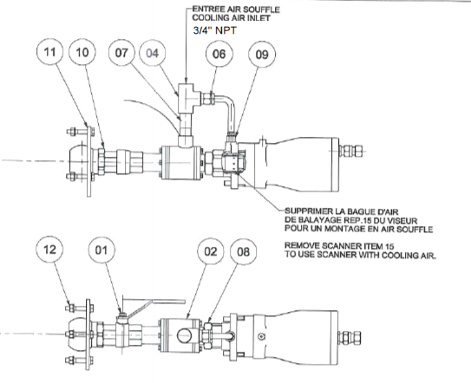
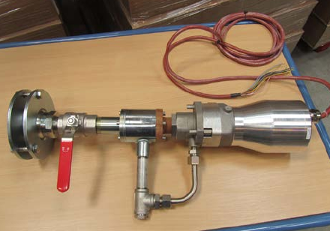
Special In duct burner mounting
01 = Ball valve G1”1/4 steel
02 = barrage air box galvanized steel
04 = Tee connector F G3/4” galvanized steel
06 = connector M G3/4” brass
07 = threaded nipple G3/4” l= 90 mm galvanized steel
08= nut G1”1/4 galvanized steel
09= connector 3/8”NPT brass
10= swivel galvanized steel (diameter 80mm)
11= flange galvanized steel (diameter of swivel mounting 170mm)
12= bolt 10X60mm galvanized steel

Slide 12
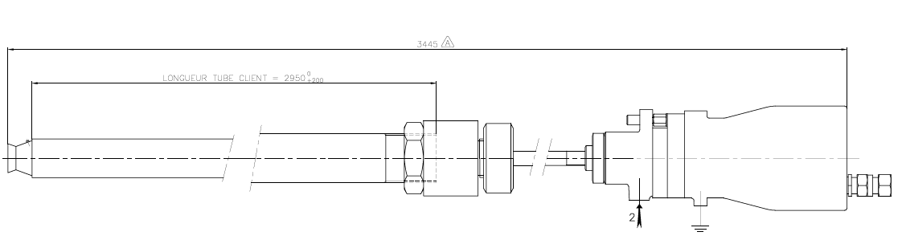
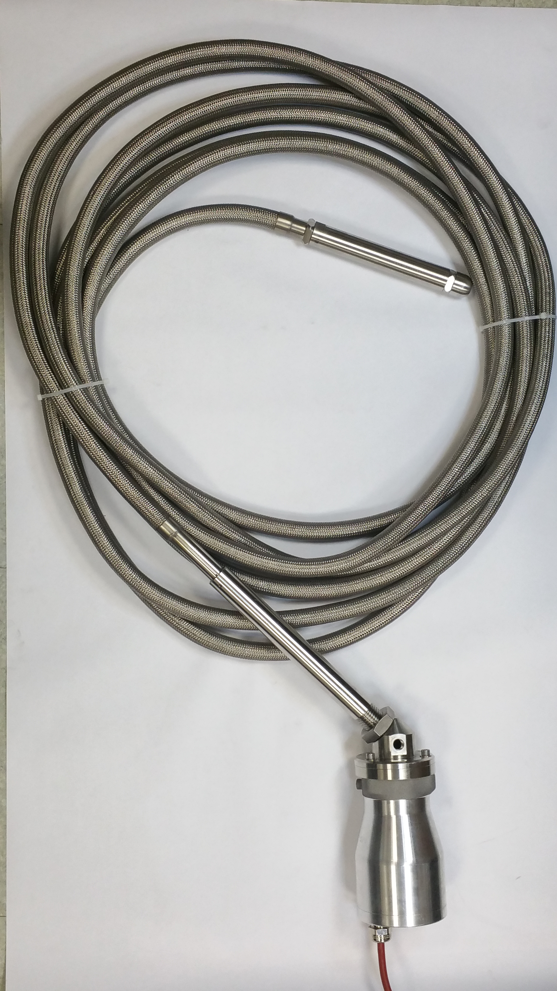
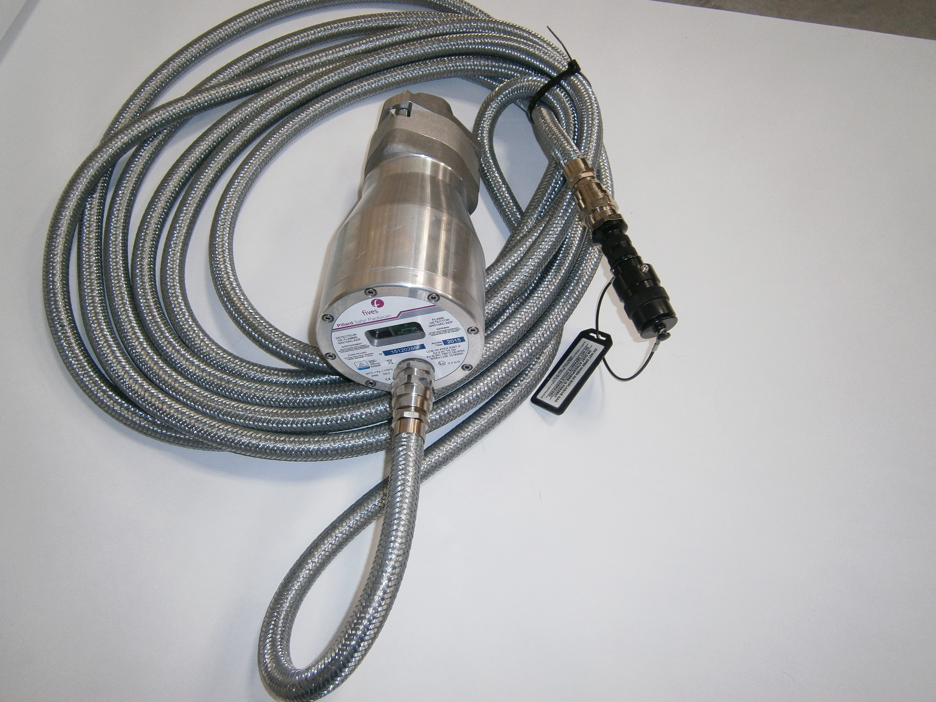
Special optic fiber scanner UV, IR or pyrometric principle
Technical features
Spectral range | UV, IR & pyrometric
Viewing angle | 15°C
Operating temperature | -40°C to + 350°C
Purge air connection | 3/8” NPT F
Guiding tube material | 1,4301 / Inox 304L
Cooling air connection | Depending on site
Warranty | 1 year

Slide 13
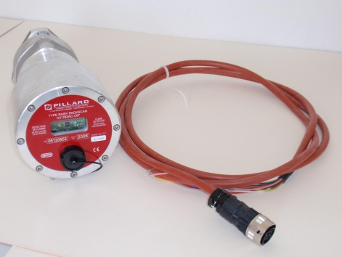
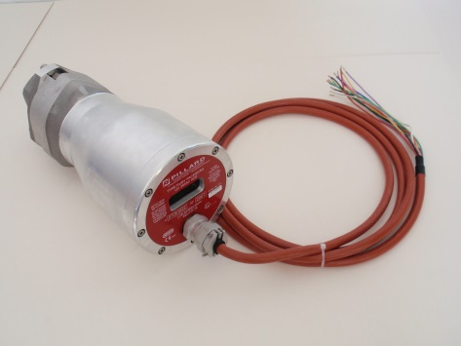
Flame detectors – Ruby Packscan, Safyr Packscan, Darkscan
Product description
The Ruby Packscan and Safyr Packscan flame detectors exist as :
C67: The cable outlet is by connector plug. Maintenance is therefore made easy.
Connector
ATEX: The cable outlet is through a cable gland. The detectors are certified II 2 GD Ex d IIC T6 and can therefore be fitted in a classified area.
Cable gland
The Darkscan flame detector is only available in the ATEX version.

Slide 14
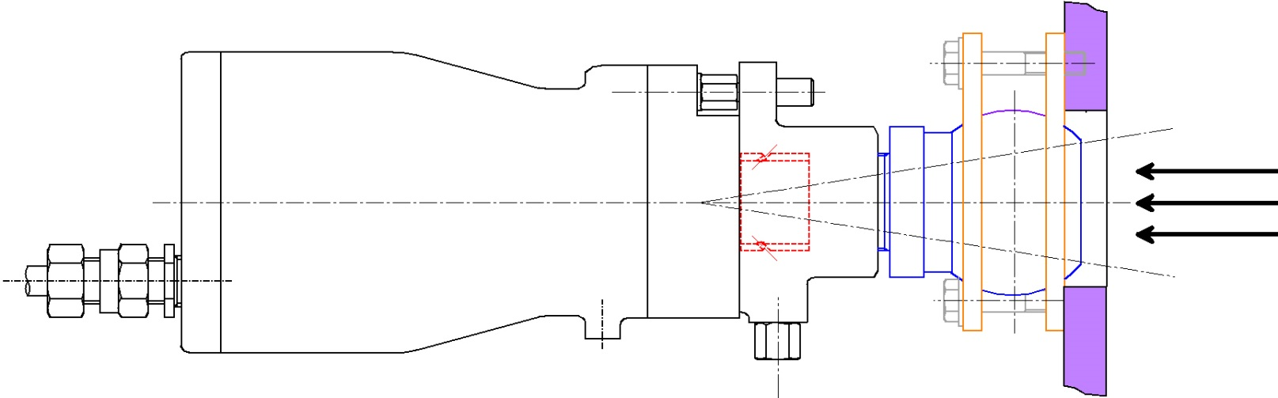
Fitting (Mechanical)
Fitting to the burner front face with a swivel mount:
Detector
Burner front face
Swivel mount
Precaution: The detector must not be exposed to temperatures > 85°C

Slide 15
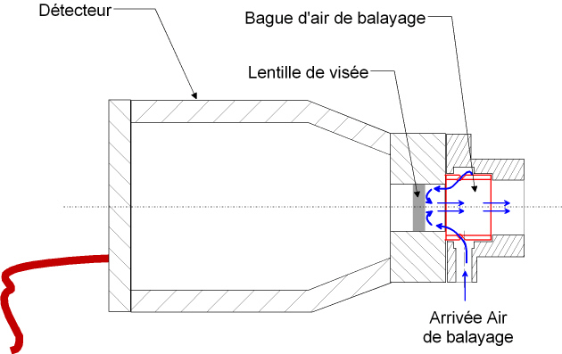
Fitting (sweeping air connection)
In order to protect the lens, sweeping air is necessary in order to ensure a barrage against dust and temperature from the burner's combustion air. The air must be clean, dry and oil free.
Detector
Sweeping air distributor
Lens
Sweeping air input
A flow rate of 3 to 7 Nm³/h is necessary :
In the case of using compressed air, for a pressure of 4-7 bars, insert a 1.2mm nozzle on the sweeping air connection. The sweeping air ring must be installed.
When using forced air, remove the sweeping air ring since no nozzle is required.

Slide 16
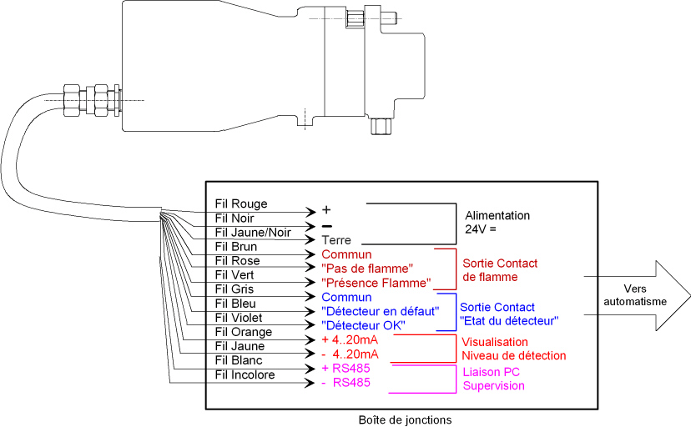
Electrical connection
Cable gland or connector
Power supply 24V
Flame Detection contact
3m high temperature cable (supplied)
Detector status
To DCS
Flame level 4-20mA
Serial link RS485
Precaution : Do not allow the detector cable to remain in the proximity of power cables.

Slide 17
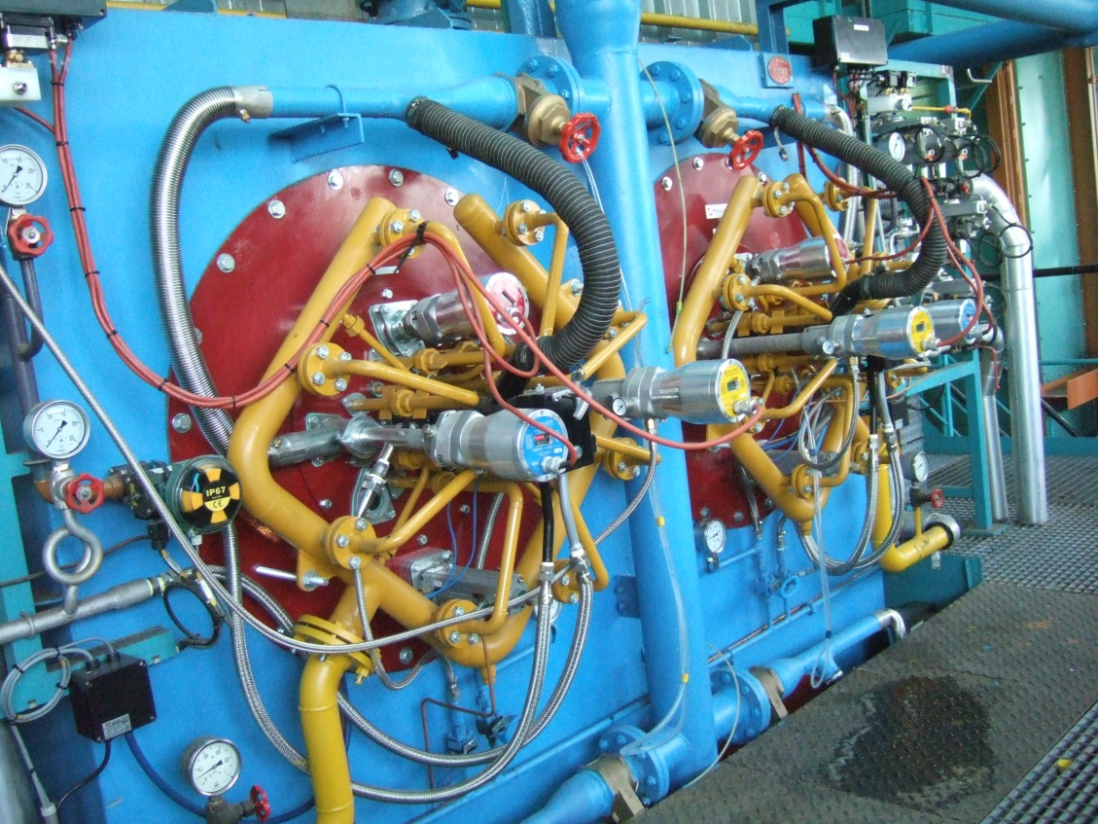
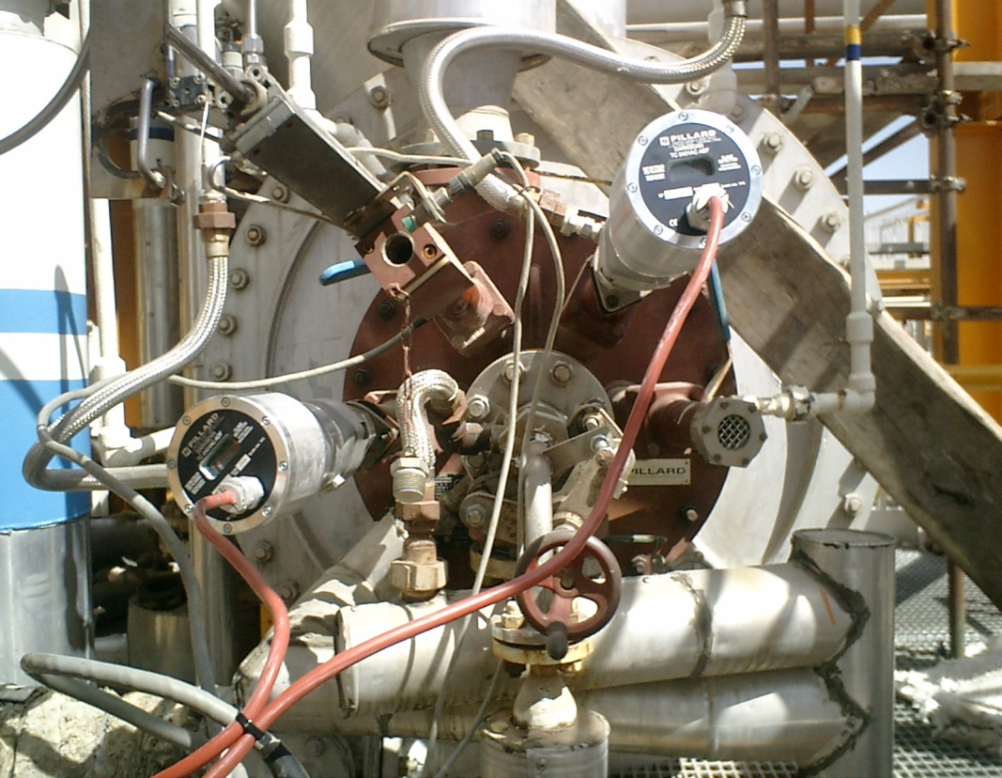
View of fitted product
Dual firing Gas/Heavy oil burner
Acid gas burner on a Claus unit
Safyr Packscan
Darkscan
Ruby packscan

Slide 18
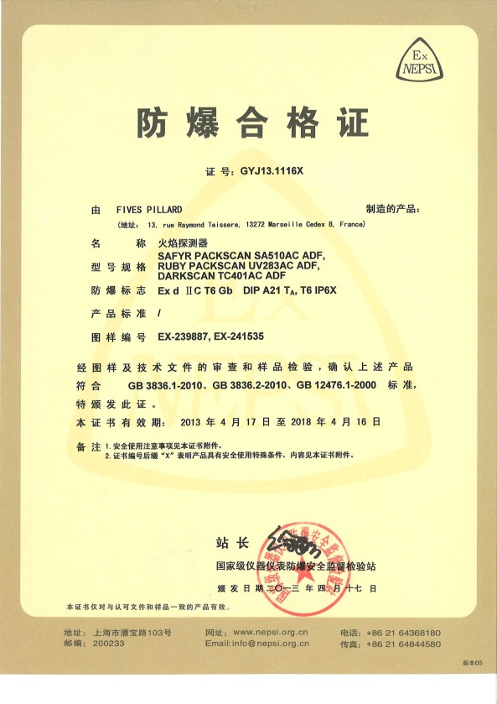
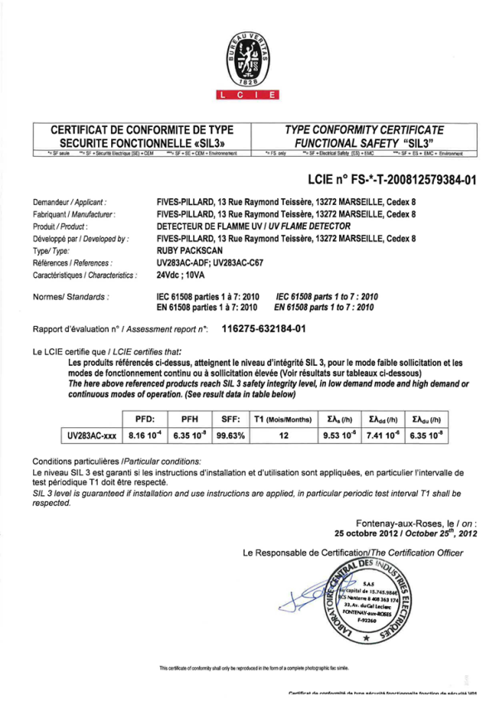

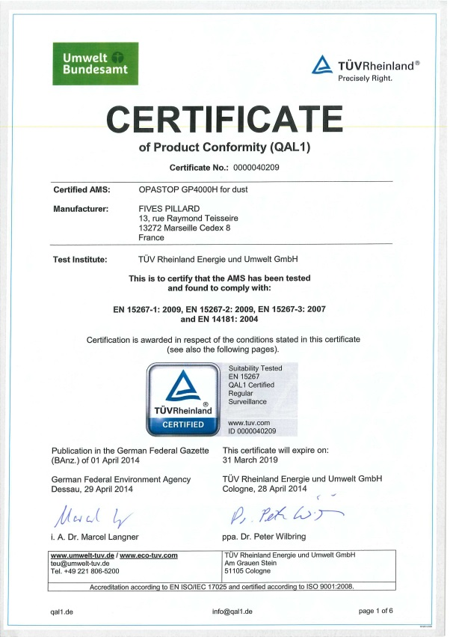
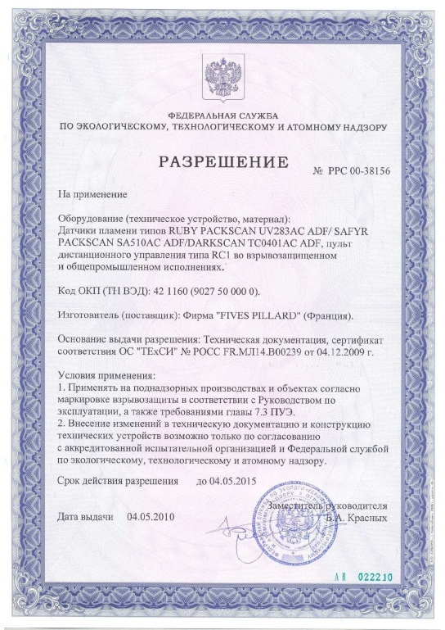


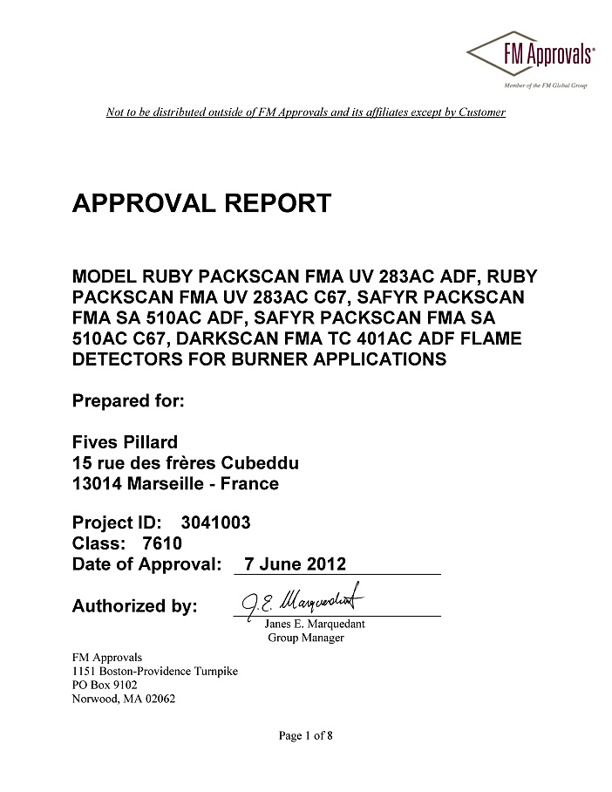
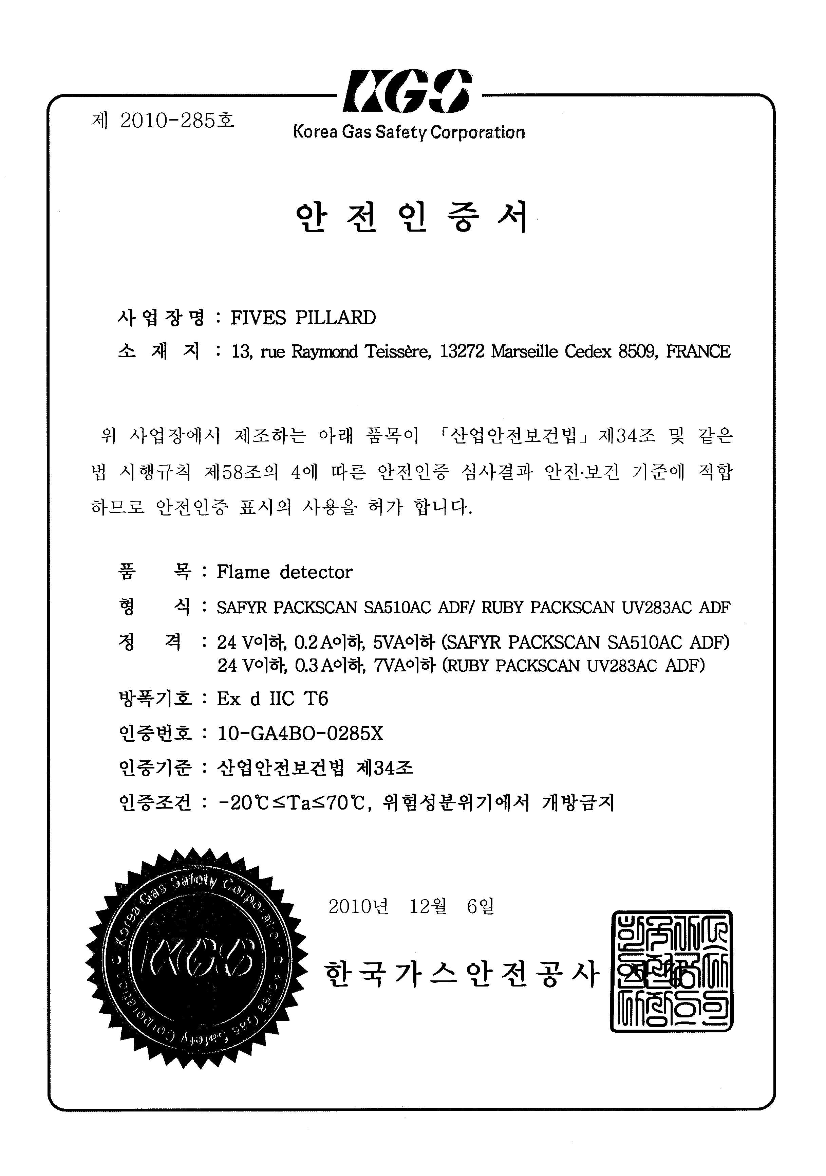



Certifications
Protection rating sealed against dust and water | IP65
Automatic control system for burners Norme EN 298
Safety level SIL 3 Norme EN 61508
NEPSI (Chinese certification)
KGS (Corean Gas safety)
EAC (Russian certification) / In progress
ATEX II 2 GD Ex d IIC T6 Standard EN 60079-0/31
FM APPROVAL
More than 15 compliances successfully validated

Slide 19
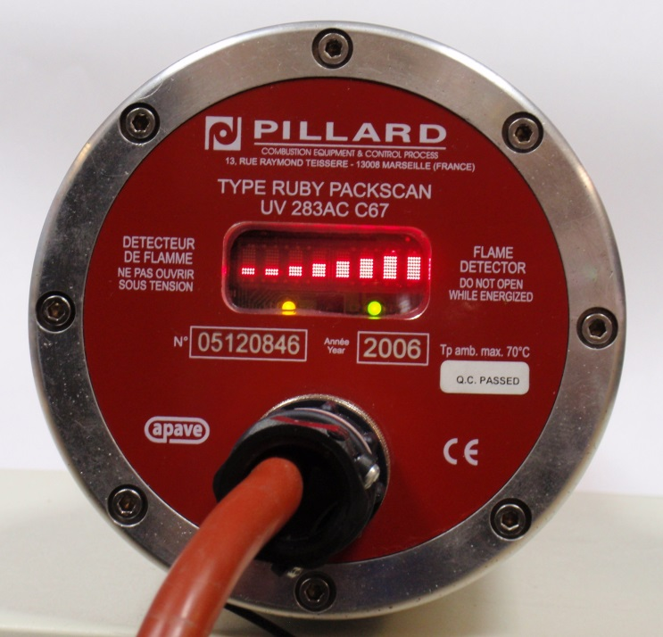
Display
Display window
Yellow indicator « Self-checking »
Green indicator « flame detected »
The detector comprises :
  Display window : it shows the flame level detected and any faults present.
  Yellow flashing indicator for "self-checking" :
    1 per second : Self checking is OK
    10 times per second : Fault present (The fault is then clearly displayed)
  Green indictor for "flame detected" : it lights up once the flame relay indicates "Flame presence"

Slide 20
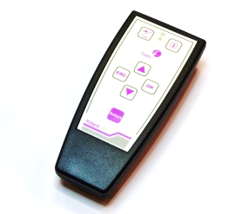
Fitting (adjustments)
With the burner in operation, orientate the detector using the swivel mount in order to obtain a maximum level of detection.
If the “Flame detection” indicator does not light, lower the detection threshold using the IR remote until a reliable detection is obtained.
Check that this detection is effective at all burner loads. If necessary, modify the orientation, and/or the detection threshold accordingly.

Slide 21
Additional adjustments
More precise can be accessed on the display panel using the IR remote (Detection threshold, minimum detection time,…..) to discriminate between the various flames:
  In installations where there are several burners
  Where the detector's line of sight takes into account several burners
Ruby Packscan
Refer to the Technical manual for further information.

Slide 22

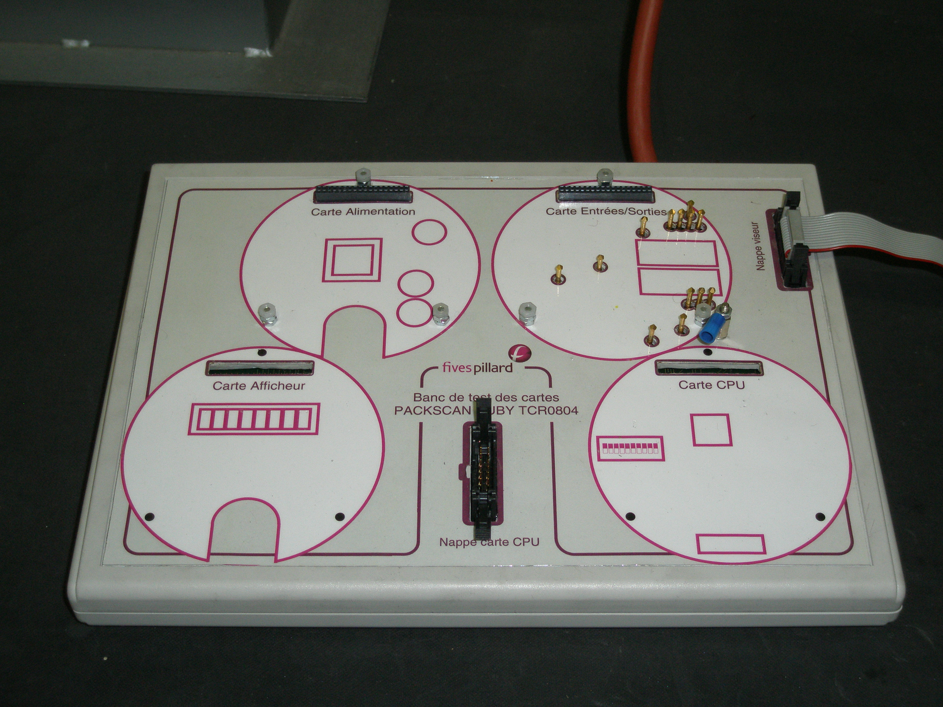
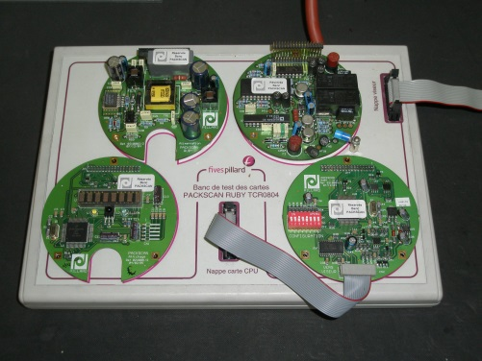
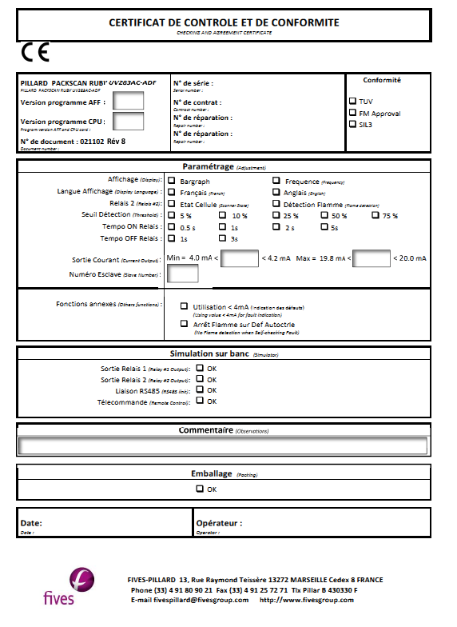
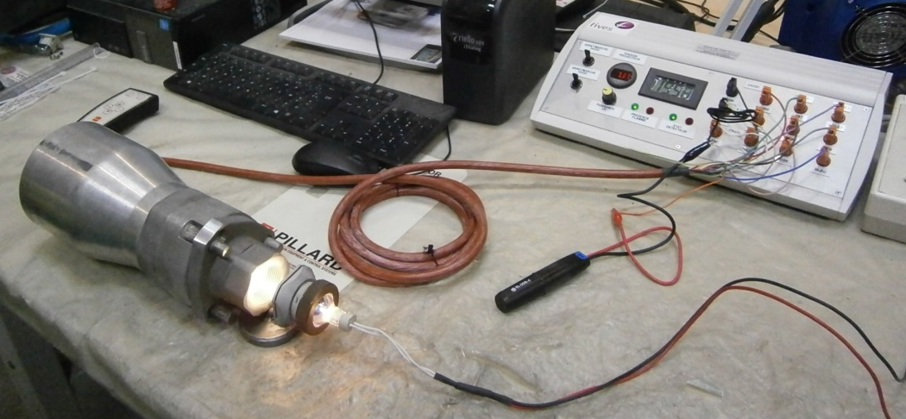
Manufacture
Made in
The flame detectors are assembled and checked in our workshop.
All the functionalities of each detector are checked on a test bench and certificate of conformity is supplied with each unit (100% tested).
Electronic board bench
Flame scanner bench

Slide 23
Analyser and Instrumentation Department
Certifications and compliances
More than 15 compliances successfully validated

Slide 24
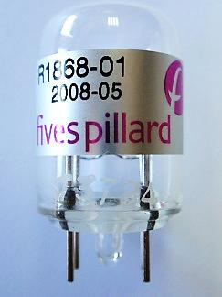
Product maintenance
Lens cleaning every 6 months
Darkcan
Lens
Safyr Packscan
Detection tube replacement once per year (lifetime of the part) for the UV scanner
Ruby Packscan
UV cell

Slide 25
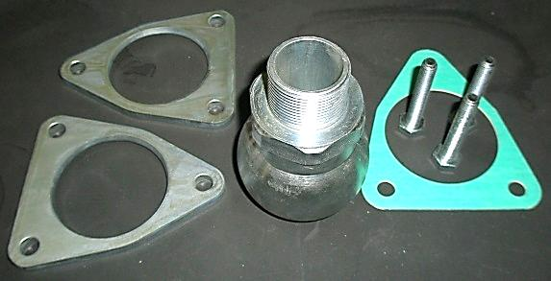
Accessories, options, services
Extra length cable
Epoxy paint coating for aggressive ambient conditions
Infrared remote (ATEX)
Swivel mount

Slide 26
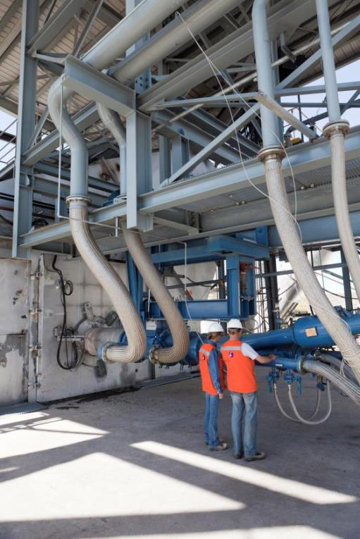

Analyser and Instrumentation Department
Our scope of services
Service in our workshop
After Sales service
Training
Service on site

Slide 27
Analyser & Instrumentation Department
Combustion
Fives Pillard
(Headquarters)
13 rue Raymond Teissère
13272 Marseille Cedex 08 – FRANCE
Tel: +33 (0)4 91 80 90 21 – Fax:+33 (0)4 91 25 72 71
Pillard-sales@fivesgroup.com

