Slide 1
Pillard Opastop® GP4000H presentation
Analyzers and Instruments Dept
02 March 2016

Slide 2

Principle of measure

Slide 3
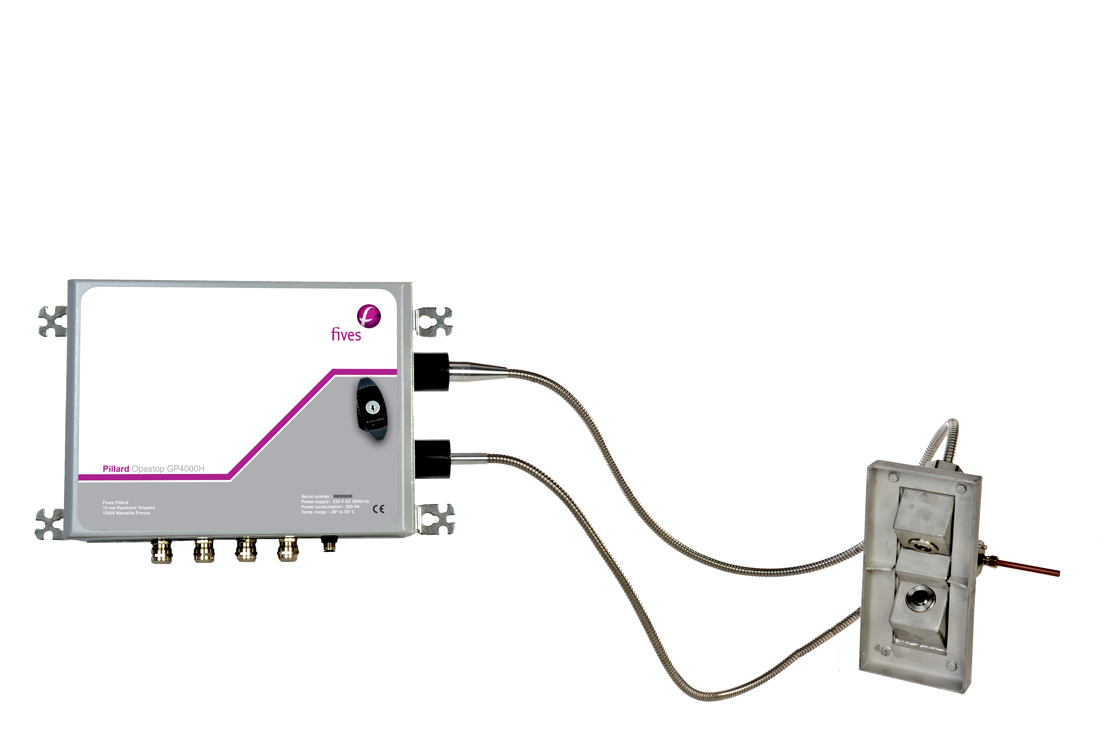

Visual set-up
Principle of measure
Air inlet
Measuring panel
Optic fibres
Sensor
Eliminate the risk of heat and vibrations of the electronic components close to the stack.
Avoid clogging of the tips of the optical fibers through the purge air injected into the sensor.

Slide 4
Presentation of the parts of the equipment
Measuring panel
Emitting
Optic fibres
Receiving
Optic fibres
Sensor and its support

Slide 5
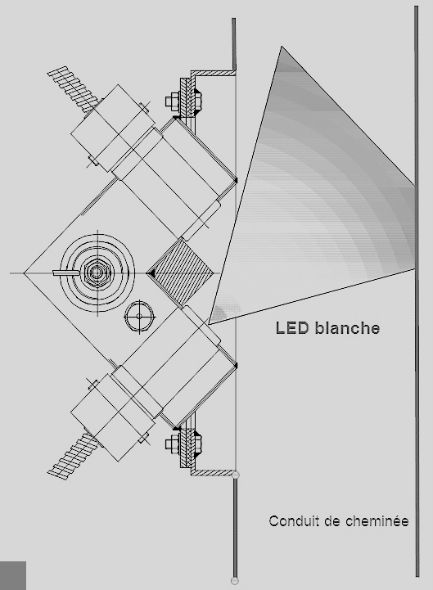

Back scattering principle
Easy to install: the sensor is installed only by oneside of the stack
The ray light, is sent into the flue gas up to 2 meters
The light ray is modulated to prevent stray light in the duct.
The light ray is white because very representative
Light is reflected gin various directions by the particles present in the duct
The light refleted is proportional to the quantity of dust
DUCT
Each particules reflect on each other and create the multi reflection effect
The BACK SCATTERING PRINCIPLE is the most sensible in low concentration.

Slide 6
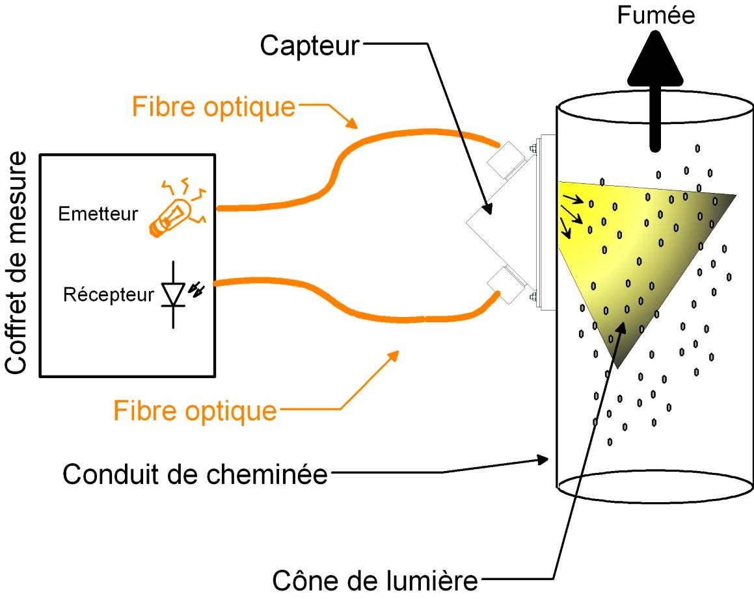
Presentation of the Pillard Opastop® GP4000H
IIlustration
A cone of light is emitted in the measurement space.
Flue gas
sensor
Optic fibre
Measuring panel
The receiving fiber collects the light and drive it into the measurement box
Cone of light

Slide 7
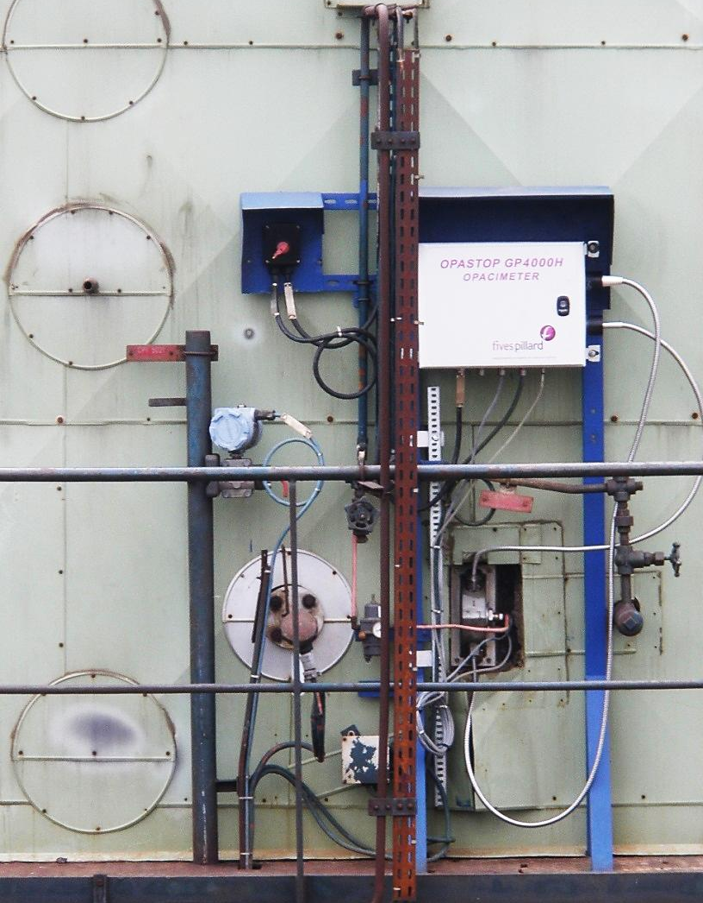
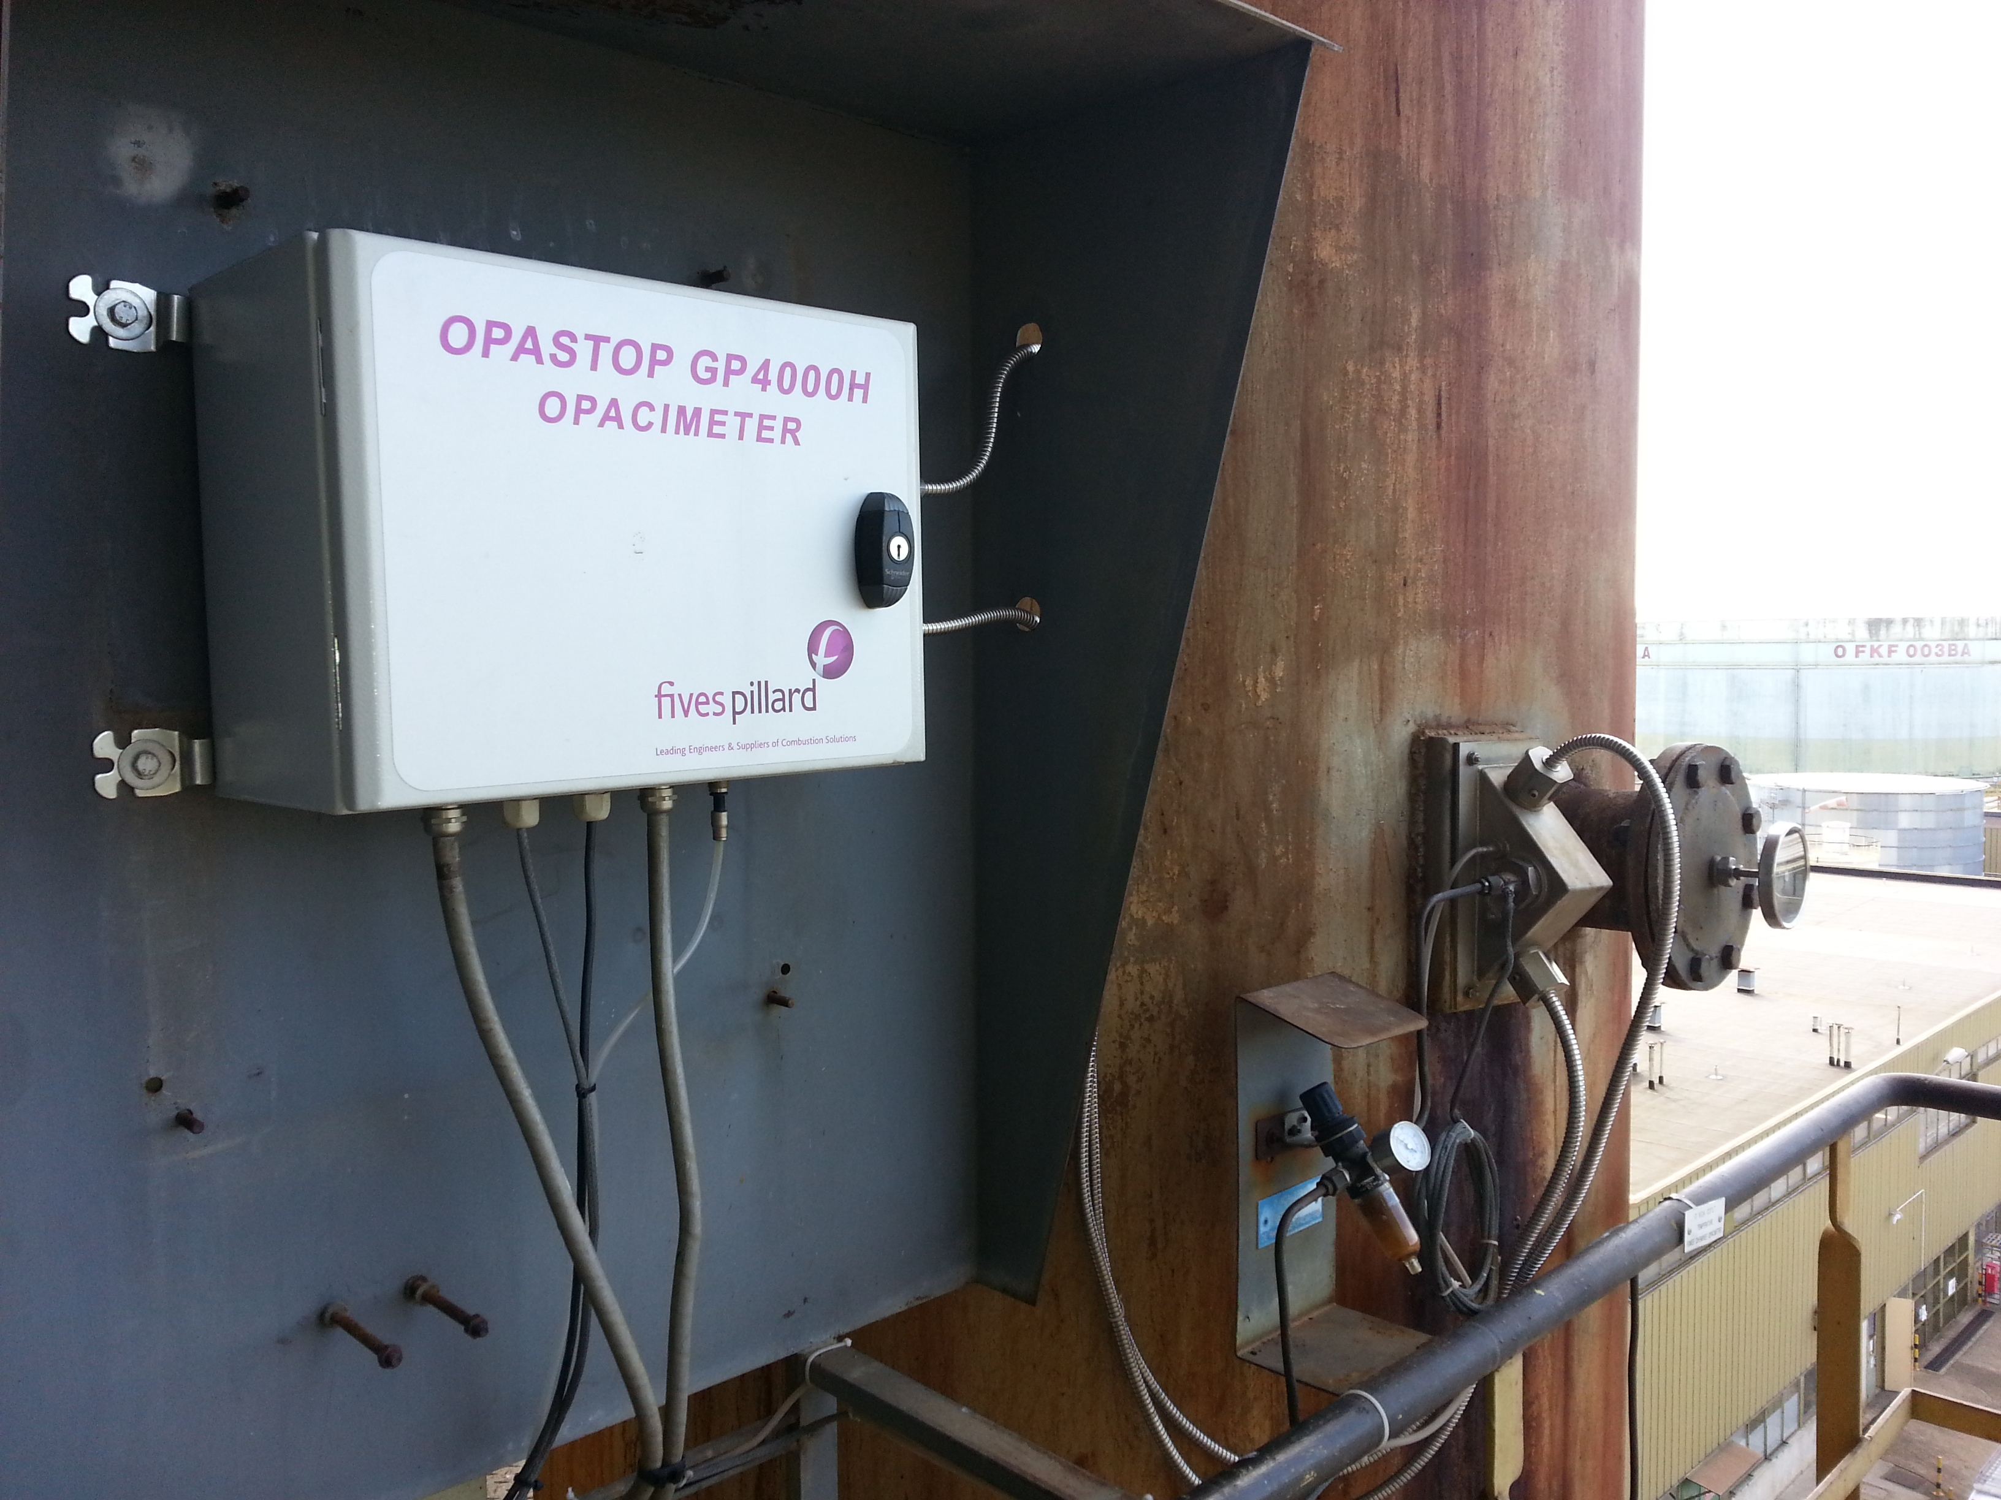
Visual presentation of the equipment installed
Duct
Measuring
panel
Sensor
Pillard Opastop® GP4000H cabinet installed on the duct
Pillard Opastop® GP4000H cabinet remoted from he duct

Slide 8

Functions et setting

Slide 9
Functions and settings
Technical specifications
Power supply | 230V / 115V (+10% / -15%) 50Hz/60Hz
Consumption | 50 VA on average (550VA with heater)
Panel operating temperature | -20°C to +50°C
Measuring range | 0 to 1 000 mg (mini: 0-10 mg)
Accuracy | < 2% of the full scale
Drift | < 3%
Display resolution | 0,1 mg (for a scale less than or equal to 100mg)
Analogue output signal | 3 4-20 mA outputs (750 Ω maxi load)
Printer/Calculator output | RS 232 / RS 485 (modbus)
Panel | Protection rating IP 55
Dimension | 300 x 400 x 200
Weight | 10 Kg

Slide 10

Installation and maintenance

Slide 11
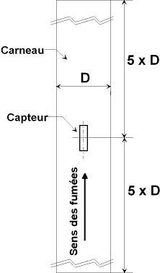

Installation and maintenance
Assembling precaution
"The sensor must be fitted at a measuring section which meets the conditions as defined in the Norm AFNOR NFX 44-052".
For ducts with a diameter less than 1m, it is imperative that the flange is fitted such that the large side of the sensor is parallel to the flue gas direction.
The sensor holding flange must be welded directly to the duct such that the sensor is flush with the inside of the duct.
So as avoid any disturbance, it is imperative that no element is closer than 1m from the sensor inside the duct. .
Move the measuring panel as far away from the stack as possible, being sure not to make the optic fibres too stretched.
duct
sensor
Sensor position

Slide 12
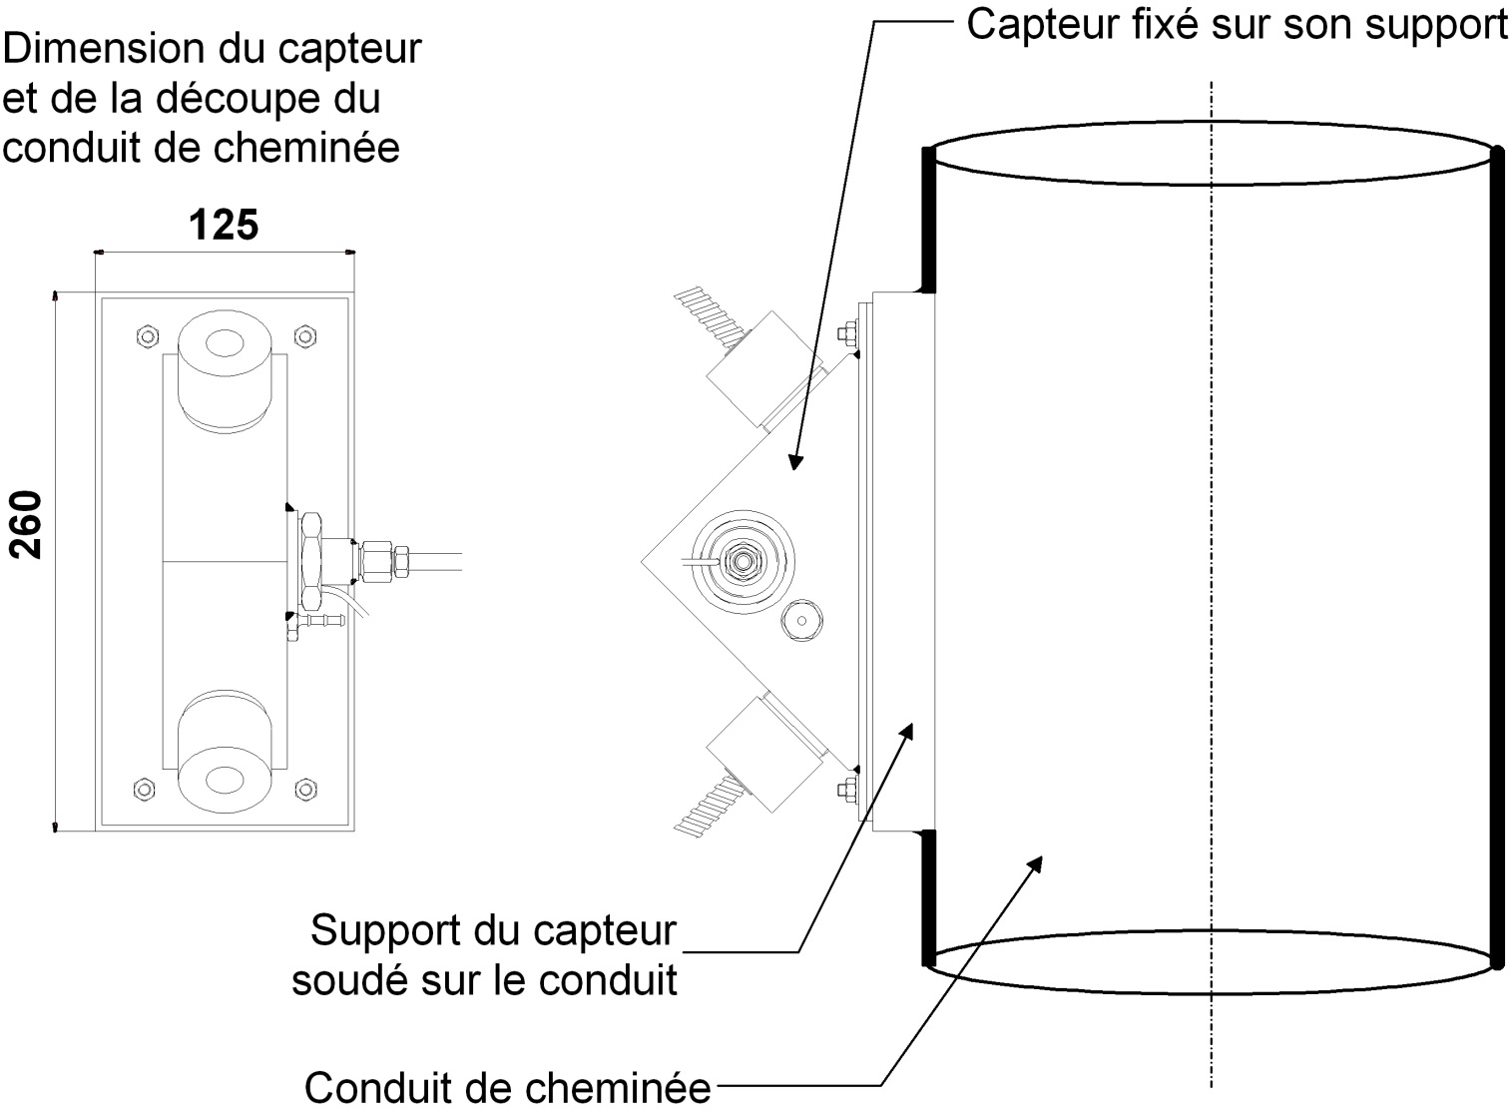

Installation and maintenance
The sensor
Dimensions of the support of the sensor
Sensor fixed on its support
Sensor support
Welded on the duct
Duct
Optic fiber must imperatively be insered until the « clic »

Slide 13

Installation and maintenance
Maintenance of the analyser
Very low maintenance
Periodic checks:
    General appearance of the unit.
    Cleanliness of the electronic card (de-dusting when de-energised)
    Cleanliness of the optical fibers ( cleaning with soft cloth without shut down)
    (nettoyage à l’aide d’un tissu doux sans arrêt du coffret).
    Status of the panel door seal
  Span check:
    Inspection once a year using the calibration control unit
    One calibration unit is enough for one plant (for several analyzers)

Slide 14
Installation and maintenance
Manufacturing
Assembling and testing in the Fives Pillard workshop
Bench test specially designed to test and run all units over a period of 15 years
Reliable product on start up

Slide 15
Installation and maintenance
Spare parts
Désignation | Reference | Lifetime
Led emission unit | P-275389 | 30000 h
Set of fuses 10 fuses 5x20 3.15AT, 10 fuses 5x20 1AT, 10 fuses MSF250 0.125A) | FU-4000 | (2)
Emitting optic fiber lenght 2,2 m | Z-279194 | (3)
Receiving optic fiber lenght 2,2 m | Z-233621 | (3)
Emitter/ Receiver unit | P-275393 | (4)
Main circuit | CP-4000 | (4)
Sensor | P-233411 | (3)
Air heater | P-253634 | (3)
2: To have in stock
3: Using parts in case of using in difficult environment
4: Parts to have in stock in case 4 weeks delivery time is not possible.

Slide 16
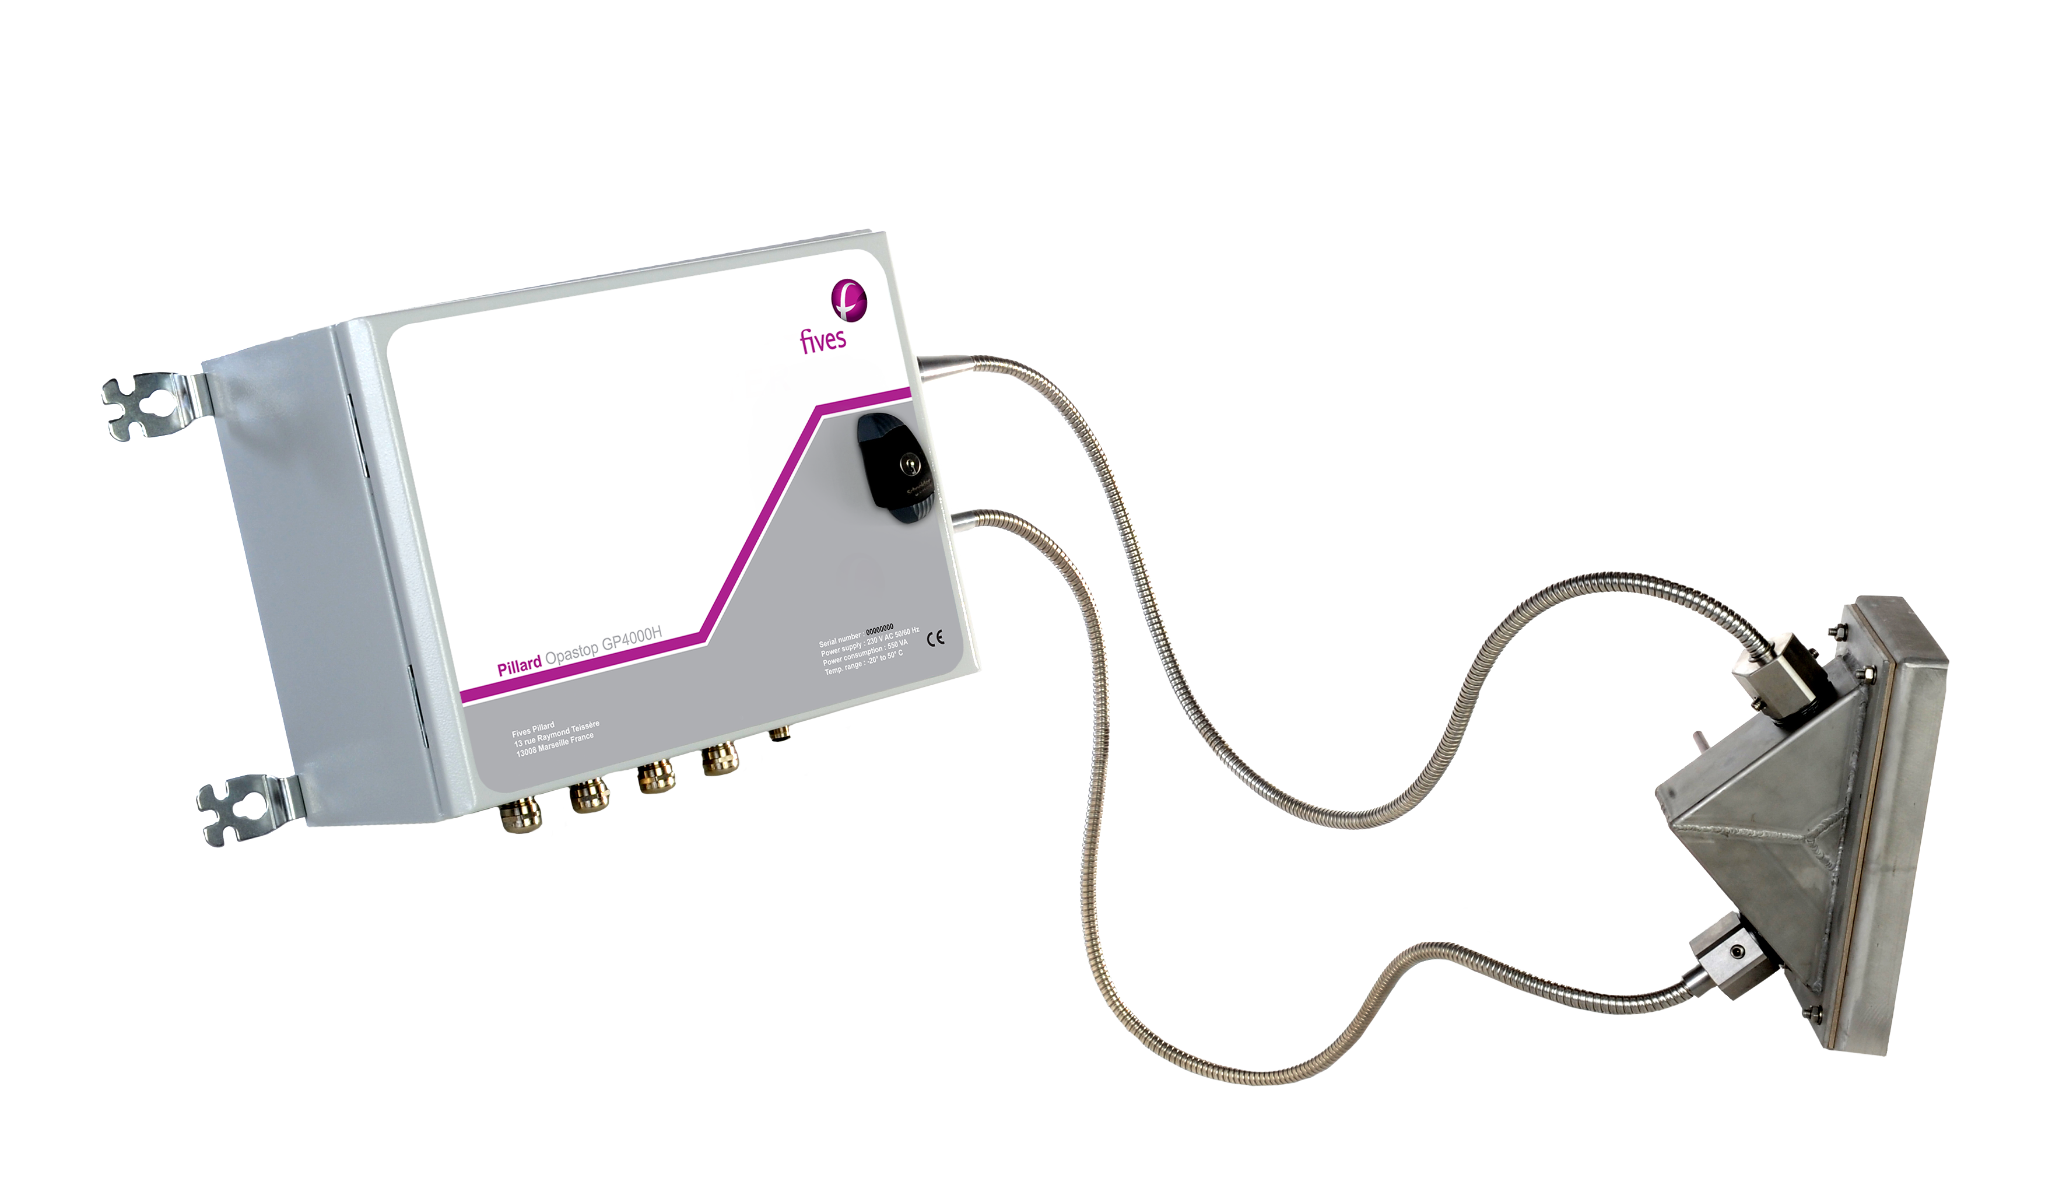

Installation and maintenance
Design and services
  Length of optical fibers
  For high temperature application(> 350°C):
    Embout de fibre haute température 450°C (Ex: fours de raffineries).
    Support de capteur haute température (< 600°C) refroidi par air soufflé (Ex: Incinérateurs)..
  Ex proof model
  Assistance service for installation, commissioning assistance, annual contract…
1,20 m
2,20 m
On demande: max 7m

Slide 17

Régulation and norms

Slide 18


Reglementations and norms
Reglementary aspect
Certification QAL1 with Cologne TUV according to norm EN14181.
Definition of standard EN14181: The ability of a measuring device to fulfil its measuring function in the laboratory.
(The equipment performance is checked by a certified laboratory)
Conformity to standard AFNOR NF X 43-302
Relating to the determination of the dust concentration by opacimetry,
for the continuous measurement of flue gas opacity

Slide 19
Advantages Pillard Opastop® GP4000H
PROVEN SOLUTION
Strong 30 years of experience for measurement with back scattering opacimeter: more than 1,000 installed worldwide
RELIABLE
Measurement with QAL1 requirements by the TUV and 3 4-20mA outputs
(including one dedicated to fouling function)
  EASY INSTALLATION AND USE
  Single sensor drilled only by one side of the stack, only one hole, no aligmnent required and insensitive to vibrations
  DURABLE
Electronics positioned away from the flue gas duct so electronic is not subject to temperature or vibrations, very robust and durable and limit the risk of destruction of the electronic
  EASY TO MAINTAIN
Thanks to modular design consisting in 3 parts (optic fibre + sensor + cabinet), the operator can replace any defected part.

Slide 20
Fives Pillard
(Siège)
13 rue Raymond Teissère,
13272 Marseille Cedex 08 – FRANCE
Tel: +33 (0)4 91 80 90 21 – Fax: +33 (0)4 91 25 72 71

